Slide 1

WG 4: Final Report
COST Action CA16123 Safety Culture and Risk Management in Agriculture (SACURIMA) Working Group 5, Core Group, Working Group 1-5, MC meeting and Workshop.
1-3.09.2021, Lisbon, Portugal
Eda Merisalu, Aurélie Berthet, Stefania Curti, Gert van der Laan, Federica Masci, Claudio Colosio

Slide 2
Objectives of the WG4
Develop means and indicators for monitoring progress and evaluating impact of interventions on injuries and illnesses in agriculture;
  To identify and analyze strengths and weaknesse;s of existing data collection mechanisms to propose improvements on reporting the national and European levels in the agriculture sector;
  To analyze the quality of the main indicators for monitoring to evaluate the impact of interventions to prevent injuries and illnesses in agriculture

Slide 3
Assessment of the Results
Objectives (1)
Develop means and indicators for monitoring progress and evaluating impact of interventions on injuries and illnesses in agriculture
National statistics and OSH survey, Eurostat and available information sources have used.
Data necessary to reach these goals are not available for the following reasons:
  Non-harmonized criteria for data collection among European countries for OD and WA
  Eurostat change the content in economic activities by the subsectors
  What is reported in some regions may be not the reality for other regions
  Migrants and other vulnerable populations: data not available
  Long time shift on OD data presentation in Eurostat

Slide 4
Objectives of the WG4
Objectives (2)
To identify and analyze strengths and weaknesses of existing data collection mechanisms to propose improvements on reporting the national and European levels in the agriculture sector
    We collected information from different reporting systems.
    Not all the Consortium Countries answered the survey.
    The composition of the Consortiums affects the possibility of all the partners to collect information on all the aspect requested.
    Not seldom the information is available only in the local language (English version non available) or data for using only in insurance company.

Slide 5
Objectives of the WP
Objectives (3)
To analyze the main indicators for monitoring to evaluate the impact of interventions to prevent injuries and illnesses in agriculture
    To study the effects of interventions we must be able to study TRENDS (before and after intervention), but this (see previous points) is currently not possible on a EU level
    Necessary to study trends at the local level using local milestones
    According to EU recommendations, necessary to consider local legislation and practice (harmonization!)
    This is our recommendation!

Slide 6
van der Molen HF, Marsili C, Vitali A, Colosio C. Trends in occupational diseases in the Italian agricultural sector, 2004-2017. Occup Environ Med. 2020 May;77(5):340-343. doi: 10.1136/oemed-2019-106168. Epub 2020 Jan 29.PMID: 31996472

Slide 7
Reports of OD cases in agriculture in Italy (2016-2017)
Cancer (n=25 )
Neurodegenerative and neurobehavioral effects (of pesticides) (n=9)
Respiratory Diseases (n=8)
Infectious Diseases (n= 6)
Mental Health (n=6)
Musculo Skeletal Diseases (n=4)
Cardiovascular Diseases (n=2) (60) (71)
Heat related Illnesses (n=2)

Slide 8
Deliverables of the WG 4
Developing means and indicators for monitoring progress and evaluating impact of interventions in agriculture (75%)
    Presentation of the trends in agriculture in the past 10 years (dynamics of NFA and FA rates by the sub-sectors, years and countries (age, gender)
    Literature analysis OD prevalence in agriculture based on short list of classification
    In order to study the trends it is necessary to have milestones (events of any type, legislation, technical etc.), the background data incl insurance of ODs and accidents
    This is currently impossible in agriculture in EU (lack of harmonization, different systems…)
    National statistics vs EUROSTAT statistics
    Reports addressed without distinction to forestry and fishery
    The “Short List of Occupational Diseases” of Eurostat a new reference for developing indicators

Slide 9
Deliverables of the WG 4
To evaluate utility and accuracy of information sources and report to the MC. (90%)
  Country cases why reporting of WA doesn’t work (different units and institutions gather the information),
  Huge differences between the national and Eurostat data (reporting?)
  Survey results showed the importnce of insurance system: no insurance, low accident rate reported. Lack of accurate insurance systems in the lots of countries.
  Changes in classification in economic sectors in Eurostat by the years doesn’t allow to compare longer trends by the sub-sector, country, age, gender ect.

Slide 10
Deliverables of the WG 4
Develop means and indicators for monitoring progress and evaluating impact of interventions in agriculture; (75%)
  NFA, FA and OD (WRD) are the main indicators for monitoring progress and evaluating impact of interventions in agriculture
  Current statistics is usable of only on the national level and depends on registering and reporting system (farmers’ society, insurance company, LI, governmental statistics agency/centre) in the country;
  The manuscript submitted to peer-reviewed summarizing literature and survey findings on prevalence of OD in agriculture;

Slide 11
First results of the systematic reviews
Many cancer studies: Remarkable is the high number of cancer studies: some are focussed on the possible association with pesticides, others are broader and in search of occupational and environmental risk factors. Among them different IARC studies.
  Most cancer studies and studies on neurodegenerative and neurobehavioral effects focus on the association with pesticide exposure
Few studies on MSD’s. Different reports mention the burden of MSD in agriculture, but just a few studies appear in our search. I missed coxarthrosis… (old review Jensen, 2007)
No studies on dermatological diseases and noise-induced hearing loss. Although allergic and irritative skin disorders and noise-induced hearing loss are well known problems in agriculture a meta-analyses on these issue was not encountered in our search.
Vulnerable groups are not well represented. Although much agricultural work like harvesting is performed by season workers or migrant workers, just in a few studies these groups are mentioned. The same is true for children and elderly workers.
Wide variety in the quality of the studies. Selective information.

Slide 12
Conclusions
Existing data collection systems on work-related diseases and WAs in agriculture vary widely within European countries.
In most countries only compensated occupational diseases are reported
In some countries self-employed and in others only employees are covered, because if differences in social security systems
Data on vulnerable groups are totally missing
Lists and criteria of Occupational Diseases differ between countries
OD data comparison is not possible

Slide 13
Recommendations
Promote a more detailed collection of data in agriculture;
Harmonising the definitions and content of economic activities;
Better insights of work-related diseases in agriculture: not only on compensation data also utilizing data sources (we will underpin some excellent examples)
To pomote the prevention/intervention of under-reporting WA and OD in EU countries;
More focus on work-related diseases in migrants and other vulnerable populations in agriculture.

Slide 14
WG4: Publications
Research articles
Van der Molen HF, Marsili C, Vitali A, Colosio C. Trends in occupational diseases in the Italian agricultural
sector, 2004-2017. Occup Environ Med. 2020 May;77(5):340-343. doi: 10.1136/oemed-2019-106168.
Epub 2020 Jan 29.PMID: 31996472
2. Merisalu, E., Jakob, M., Leppälä, R., Rautiainen, R. 2019. Variation in European and national statistics of
accidents in agriculture. Agronomy Research 17(5), 1969–1983.
3. Enn, A., Merisalu, E. (2019). Dynamics of WA incidence by severity, gender and lost workdays in Estonian
agricultural sector and sub-sectors in 2008–2017. Agronomy Research 17(4), 1617–1629.
https://doi.org/10.15159/ar.19.169
Conference abstracts and oral presentations
Merisalu, E. 2021. Trends on work accidents in agriculture in EU countries. BSE2021, Tartu 5-7- May 2021.
John McNamara, J. 2021. Promoting Farmer occupational safety and health (OSH) services through Extension. BSE2021, Tartu 5-7- May 2021.
Leppälä, J., Karttunen, J., Van Den Broucke, S. and Rautiainen, R. 2021. Development of Farm Safety Culture in Finland. BSE2021, Tartu 5-7- May 2021.
C. Colosio, S. Mandic-Rajcevic, L. Godderis, G. van der Laan, C. Hulshof, F. van Dijk. (2017). Workers’ health surveillance: implementation of the Directive 89/391/EEC in Europe. Occupational Medicine doi:10.1093/occmed/kqx113

Slide 15
Conference abstracts and oral presentations (cont)
1. Leppälä, J., Jakobs, M., Merisalu, E., Rautiainen, R. (2018). Quality of statistics in agriculture – a comparison of European countries. 9th International Conference on Biosystems Engineering, BSE2018. May 09-11, Tartu, 2018. USB Abstract Book. (Oral presentation).
6. Mc Namara, J., Leppälä, J., van der Laan, G., Colosio, C., Jakob, M., van der Broucke, S., Girdziute, L., Merisalu, E., Heiberg, A.M., Rautiainen, R. (2018). Safety Culture and Risk Management in Agriculture (SACURIMA). Occup Environ Med 75(Suppl 2):A1–A650. Conference: 32nd Triennial Congress of the International Commission on Occupational Health (ICOH), Dublin, Ireland, 29th April to 4th May 2018.10.1136/oemed-2018ICOHabstracts.1314 DOI: 10.1136/oemed-2018-ICOHabstracts.1314
7. Enn, A., Merisalu, E. (2019). Causes and consequences of work accidents in Estonian agriculture. 27th International Epidemiology in Occupational Health (EPICOH) conference 2019: Health and environment at work: The need for solutions. Wellington, Aotearoa, New Zealand. 29.04.-2.05.2019. Occup Environ Med 76 (Suppl 1) A99; DOI: 10.1136/OEM-2019-EPI.271
8. Mc Namara, J., Leppälä, J., van der Laan, G., Colosio, C., Jakob, M., Vander Broucke, S., Girdziute, L., Merisalu, E., Heiberg, A.M., Rautiainen, R. 2018. Safety Culture and Risk Management in Agriculture (SACURIMA). Occup Environ Med 75(Suppl 2):A1–A650.
9. Merisalu, E., Leppälä, J., Rautiainen, J., Colosio, C. (2018). Strenghts and weaknesses of existing data collection mechanisms about health surveillance in EU countries. Workshop Meeting, Antalya, Turkey, 7 March 2018. (oral presentation).
10. Jarkko Leppälä, Martina Jakob, Eda Merisalu, Risto Rautianen. (2018). Quality of EU statistics on work accidents in agriculture – a country comparison. 9th International Conference on Biosystem Engineering BSE2018. Tartu, EULS, 9-11.05.2018.
11. Anni Enn. (2018). Dynamics of non-fatal and fatal work accidents in agriculture in the past decade in Estonian agriculture. 9th International Conference on Biosystem Engineering. BSE2018. Tartu, EULS, 9-11.05.2018.
12. Merisalu, M. Jakob, J. Leppäla, R. Rautiainen. Strengths and weaknesses of existing data collection mechanisms. National Meeting on Agricultural Occupational Health and Safety (NMAOHS), Hurdalsjön Hotel, Norway. 11.09.2018.
13. Anni Enn. (2018). Mapping of work accidents in Estonian agriculture. The 1st international conference on ergonomics „Ergonomics 20 * Estonia 100“. Abstracts book. EMU, Tartu, 25.10.2018.
14. Merisalu, E., Jakob, M., Leppälä, R., Rautiainen, R. (2019). Variation in European and national statistics of accidents in agriculture. Agronomy Research 17(5), 1969–1983. https://doi.org/10.15159/ar.19.190.
15. Enn, A. (2018). Prevalence and dynamics of WAs in Estonian Agriculture in 2008-2017. Master Thesis. Tartu, EULS, 107 pp. (MSc)

Slide 16
Master thesis
Anni Enn. Prevalence and dynamics of WA in agriculture in 2008-2017. Master thesis. Tartu, EULS, Inst Technology, 2018. (MSci).
Janne Udeküll Employers’ assessments of occupational hazards and for accidents at work in Estonian agriculture. Master thesis. Tartu, EULS, Inst Technology, 2021. (MSci).
Two scientific missions have supported based on WG4 activities.

Slide 17

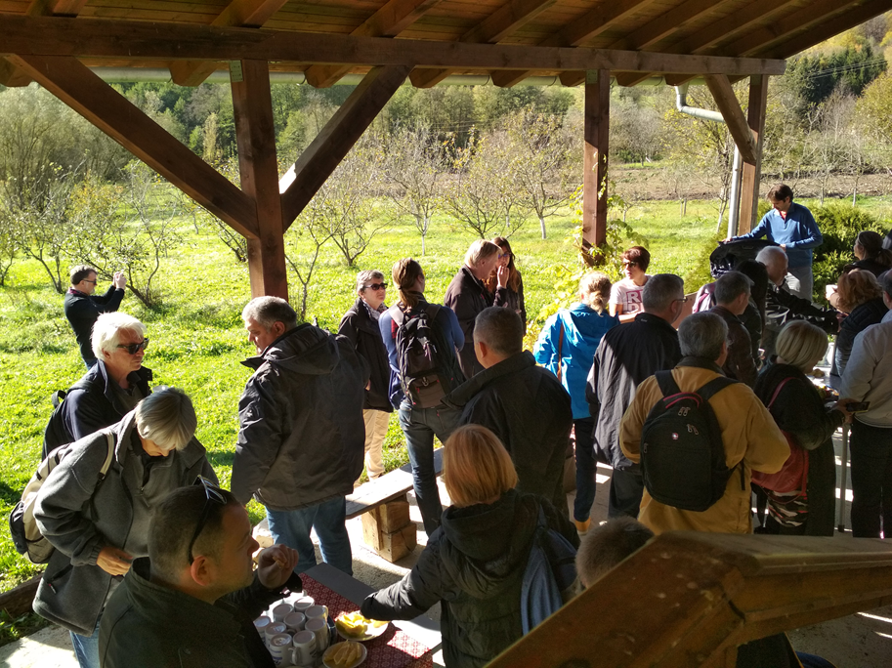
Thank you all for very nice collaboration!

