Slide 1
EU-OSHA’s role and possible future plans in the agriculture sector
Annick Starren, EU-OSHA
3 September 2021, COST Action Safety Culture and Risk Management in Agriculture (SACURIMA),

Slide 2


European Agency for Safety and
Health at Work (EU-OSHA)
A body of the EU
Established in 1996 in Bilbao, Spain
EU-OSHA is committed to making Europe a safer, healthier and more productive place to work, by promoting a culture of risk prevention to improve working conditions in Europe.
Tripartite Board bringing together:
    governments, employers’ and workers’ organisations
    the European Commission
Notes:
The Agency’s vision is to be the European centre of excellence for occupational safety and health information, promoting a preventive culture to support the goal of making Europe’s current and future workplaces safe, healthy and productive, and we have identified our values as being pan-European; relevant and responsive; reliable and transparent; tripartite; and partnership- and network-based.

Slide 3

EU agencies
(https://youtu.be/r5uTJZ6JVoY)

Slide 4
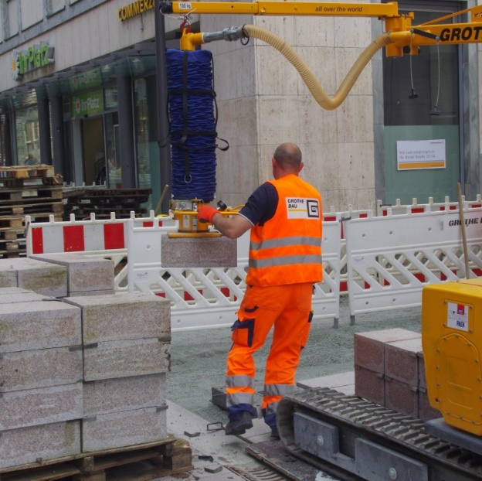
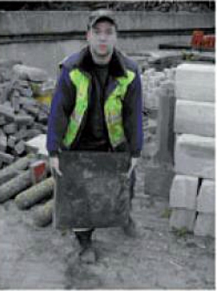
What we do and do not do
Collect, analyse and disseminate information
Make legislation
Inspect workplaces
Enforce the law
Notes:
Our main function is to contribute to the improvement of life in the European Labour Union . We work with governments, businesses , entrepreneurs, and workers Formenta a culture of risk prevention . We analyze the latest scientific and statistical research on the risks at work. We anticipate new and emerging risks . We define and share information , best practices , and advice with a wide audience , composed of the social partners , employers' federations and unions. What the Agency does not? The agency makes no legislation or policies. This is the function of the European Commission, but we work with DG Employment, Social Affairs and Equal Opportunities of the European Commission to provide an evidence base for the law , policies and strategies. The Agency does not conduct labor inspection functions and the application of health and safety legislation . This is the function of labor inspectorates . But the Agency is working with the Committee of Senior Labour Inspectors (SLIC ) to ensure common standards in the European Union .

Slide 5
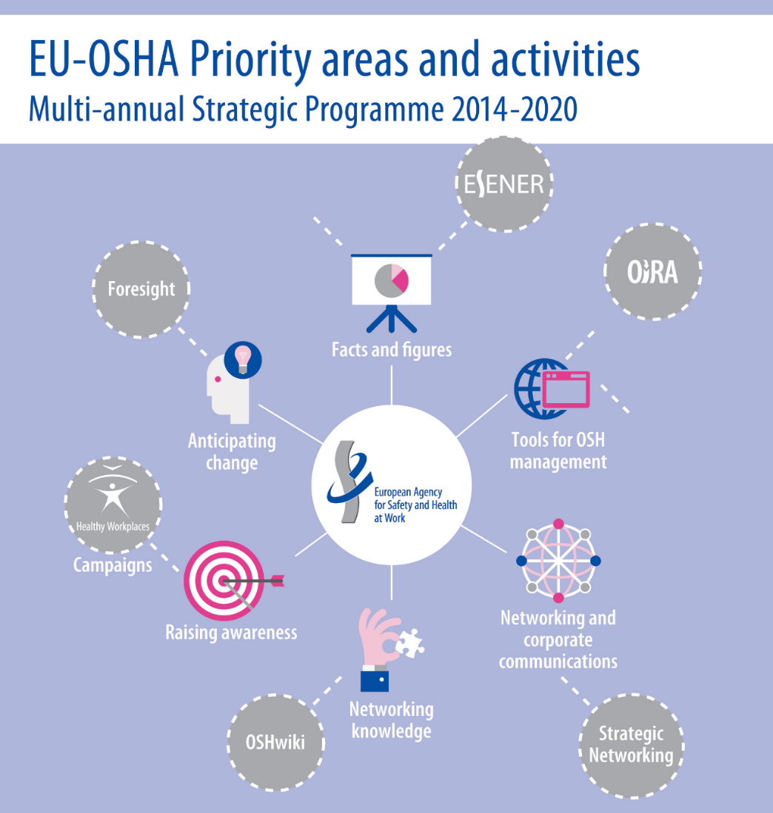
European Agency for Safety and Health at Work (EU-OSHA)
Who we are
What we do/ don’t do
How we do it

Slide 6
European Agency for Safety and Health at Work (EU-OSHA)
Who we are
What we do/ don’t do
How we do it: 5 priority areas
  Produce reliable and relevant information
  User-friendly tools
  Share good practices
  Network with organisations across Europe

Slide 7










EU-OSHA: Campagnes more than 16 years
 | 2010-2011: Safe Maintenance campaigns
 | 2008-2009: Risk Assessment campaigns
 | 2007: Lighten the Load, Musculoskeletal disorders (MSDs) campaigns
 | 2006: Young people campaigns
 | 2005: Stop that noise campaigns
 | 2004: Building in safety campaigns
 | 2003: Dangerous substances, handle with care campaigns
 | 2002: Working on stress campaigns
 | 2001: Success is no accident campaigns
 | 2000: Turn your back on musculoskeletal disorders
Notes:
2012- 2013 Leadership in OSH
2014-2015: Stress management
2016-2017: Ageing workers
2018-2019: Dangerous substances.
EU-OSHA has been campaigning since 2000, on topics as diverse as MSDs, Stress, Noise, Young workers, Construction and maintenance.
Our devolved campaigning model allows for Member States to tailor the campaign and works closely with the social partners.

Slide 9
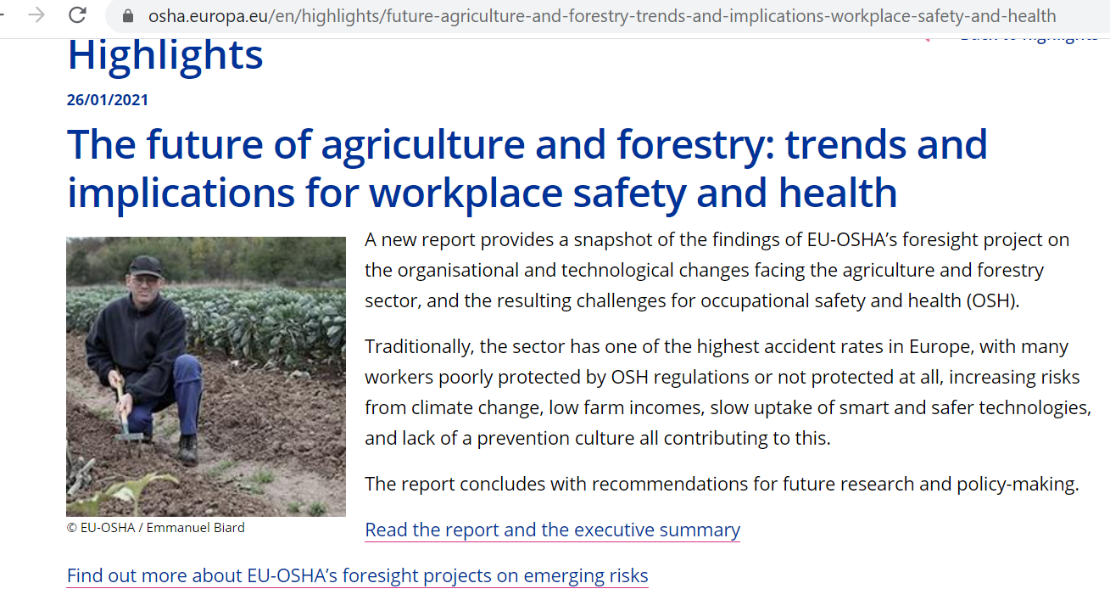
EU-OSHA and Agriculture: Report on The future Agriculture and OSH (2021)
Report and summary
published in January.
The OSHwiki and
3 policy briefs are
published in resp.
Q1,Q2,Q3
(to support further
dissemination of the
report in the sector).
Notes:
In January the foresight publications related to Agriculture (report and summary) have been promoted on our website and via facebook/linkedin/twitter, see the link below.
From March on an Oshwiki as well as 3 Info sheets will be published to continue creation of awarenes in the sector.
Input or ideas for distribution or awareness approaches of the report and its policy briefs in the sector are welcome.

Slide 10
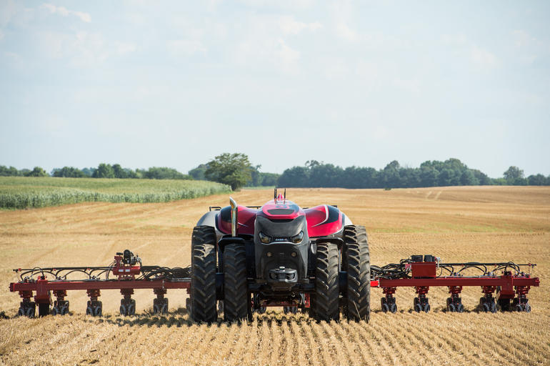
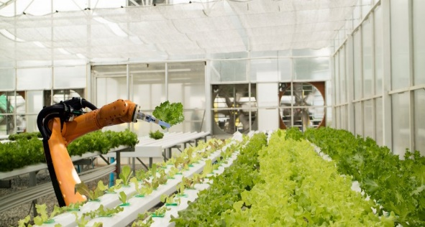
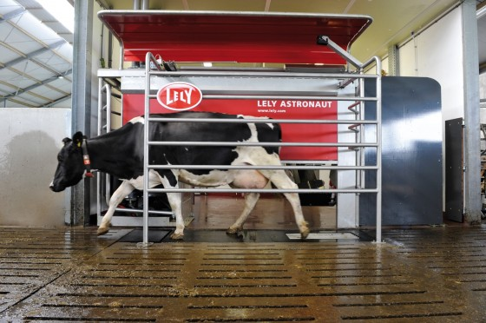

How will future development impact on OSH in agriculture? (and how to anticipate)?
Sectors covered:
Agriculture, horticulture/ greenhouse activities, livestock farming and forestry.
Target audience: policy makers at EU and national level, incl. social partners, legislators and enforcement authorities, researchers and policy-makers in related areas.
Main objective of the expert review
Notes:
KEY TRENDS – resulting in TECHNOLOGICAL and ORGANISATIONAL changes - OSH OUTCOMES.
This report reviews the future trends in agriculture and forestry, identifies the resulting technological and organisational changes in the sector and defines the implications for occupational safety and health of farmers, foresters and other workers. The report also looks at some of the existing or residual risks in the sector and assesses how new technologies or other trends such as climate change might affect the degree of risk in the future. The review aims to support policy-makers at European and national level in their development of strategies, regulation, enforcement, guidance and support measures.
Again looking at technology effects in the future?

Slide 11
Based on conclusions of the report on The future Agriculture and OSH…
EU Farm to Fork Strategy has recognised the importance of the EU Pillar of Social Rights and its application to the sector.
However, there is still a major social-economic deficit in farming, owing to the marginal profitability and income for many small farmers,
which limits the ability of the sector to fully embrace and manage the growing trends, such as digitalisation, climate change, society pressures and labour market developments and is very much linked to the poor level of OSH protection.
Notes:
However,
Farming and forestry remain one of the most dangerous sectors!
Underreporting of accidents is a major problem!
The impact of smart technologies is expected diverse:
Low uptake, digital divide, complicated processes….
A stronger focus should be put on the self-employed to include them in OSH strategies!

Slide 12
Based on conclusions of the report on The future Agriculture and OSH…
EU Farm to Fork Strategy has recognised the importance of the EU Pillar of Social Rights and its application to the sector.
However,
Farming and forestry remain one of the most dangerous sectors!
Underreporting of accidents is a major problem!
The impact of smart technologies is expected diverse:
Low uptake, digital divide, complicated processes….
A stronger focus should be put on the self-employed to include them in OSH strategies!

Slide 14
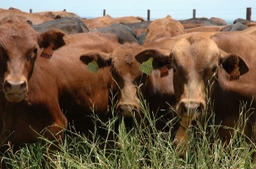

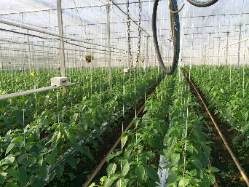
EU OiRA agricultural tool (under development)
New OiRA tool for the agricultural sector with a focus on animal farming/ fruit and vegetable cultivation (and general OSH risks) is being developed by the EU social partners (OiRA steering committee - experts from EFFAT and copa- cogeca) with the support of EU-OSHA.
Notes:
We made very good progress at the May OiRA steering committee meeting and hopefully will be able to finalise the full content of all OiRA modules before summer so that the testing of the new tool can start in autumn.

Slide 15








OiRA – basic principles
Risk Assessment
Legal obligation
Online tool
Sectoral approach
Software +
Free!
Open source
anonymous

Slide 16





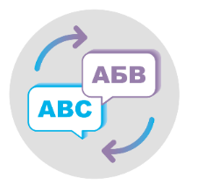

Cooperation at EU level with EU Social Partners
EU-OSHA
OiRA tools generator
EU Sectoral
Social Dialogue
General
EU Tool
National OiRA
& Social Partners
National
Tool
Small & micro

Slide 17
EU OiRA agricultural tool - EU Social Partner cooperation (under development)
The draft tool contains specific modules on working in greenhouses, working in sorting and packing facilities, working in orchards, working on crop fields, handling livestock, buildings & yards, installations and confined spaces, machinery, work equipment and vehicles, agricultural vehicles, exposure to hazardous substances, psychosocial risks, work organisation, outdoor work, lone working as well as Occupational Safety and Health management.
The OiRA tool will be finalised and published by end of this year after a testing by experts at https://oiraproject.eu/en/oira-tools
Notes:
the OiRA is still under development but you could put this:
OiRA tool for the agricultural sector with a focus on animal farming/ fruit and vegetable cultivation (but also covering general OSH risks) will be published by end of this year.
It is being developed by the EU social partner (OiRA steering committee with experts from EFFAT and copa- cogeca) with the support of EU-OSHA.
We made very good progress at the May OiRA steering committee meeting and hopefully will be able to finalise the full content of all OiRA modules before summer so that the testing of the new tool can start in autumn.

Slide 19
Project/OSH overview:
Supporting compliance and better OSH practice
Aim: to foster an environment or ‘context’ that incentivises and assists enterprises – particularly small and micro – to fulfil their obligations under OSH regulations.
Specifically, this OSH overview aims to:
Identify innovative enforcement approaches taken by authorities
Analyse the use of external prevention services
Assess the effectiveness of social reporting initiatives in fostering better OSH performance
Investigate the impact of supply chain initiatives.
Review the use of economic incentives with the aim of raising awareness about success factors

Slide 20
Focus on: Agri-Food Sector
5,5% of EU-GDP, 23 Million workers in the Agri-Food-Sector
(incl. agriculture, food and drink industry, wholesale and retail)
Few multinationals dominate the sector
Many SMEs, average 16 workers
EU Farm to Fork Strategy – for a fair, healthy and
environmentally-friendly food system
  The COVID-19 pandemic shows the importance of critical staff
  European Pillar of Social Rights to be respected
  Many precarious, seasonal and undeclared workers
  workers’ OSH, social protection, working and housing conditions
COVID-19 outbreaks across Europe, e.g. meat industry
New supply-chain legislation on national and European level
Notes:
The COVID-19 pandemic has also made us aware of the importance of systemically important staff, such as B. of those employed in the agri-food sector. For this reason, it will be particularly important to mitigate the socio-economic impact on the food chain and to ensure that the principles enshrined in the European Pillar of Social Rights are respected, particularly with regard to precarious, seasonal and undeclared work. Issues such as the social protection of employees, working and living conditions as well as health and safety at work will play an important role in building fair, strong and sustainable food systems.

Slide 21
Example: Supporting compliance
Accident insurance: premium reduction
Supply chain:
More and better contracts
Larger enterprise
Small enterprise: Certified OSH management system
Labour inspectorate:Less inspections
CSR recognitions
Notes:
What factors provide capacities for coordinated actions to support leverage of improved OSH within supply chains?
Who takes the leadership, e.g labour inspectorate, accident insurance
What incentivises positive supply chain actions and determines their transfer and sustainability?
Pressure from clients, consumers, reputation, economic pressure
Economic incentives for OSH managment systems
Social reporting
How do national contexts support or constrain using supply chain relations to promote OSH among suppliers?
Social insurance system
What are the innovative enforcement approaches among regulatory agencies in relation to supply chains and how effectively are they delivered in EU Member States?
Supply chain X-ray
Social media
Blaming, shaming
What is the role of regulatory inspection in addressing supply chain influences in their actions to enforce compliance in EU member States?
Supply chain laws
What is the role of other OSH specialist inputs in achieving supply chain leverage?
e.g. Construction safety coordiantors

Slide 23
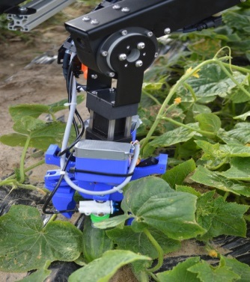
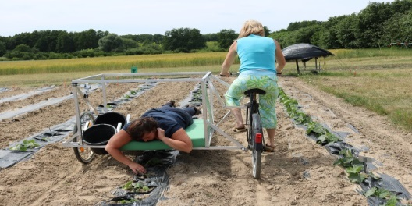
Examples of Information sources
Several articles on e.g. MSD‘s, Biological Agents and pesticides
- https://osha.europa.eu/en/publications/msds-agriculture-sector-identifying-risks-adopting-preventive-measures/view
- https://osha.europa.eu/en/publications/exposure-biological-agents-and-related-health-problems-arable-farming/view
- https://osha.europa.eu/en/publications/exposure-biological-agents-and-related-health-problems-animal-related-occupations/view
- https://oshwiki.eu/wiki/Agriculture_-_Use_of_pesticides/plant_protection_products
- https://oshwiki.eu/wiki/Psychosocial_issues_in_the_agriculture_sector

Slide 24
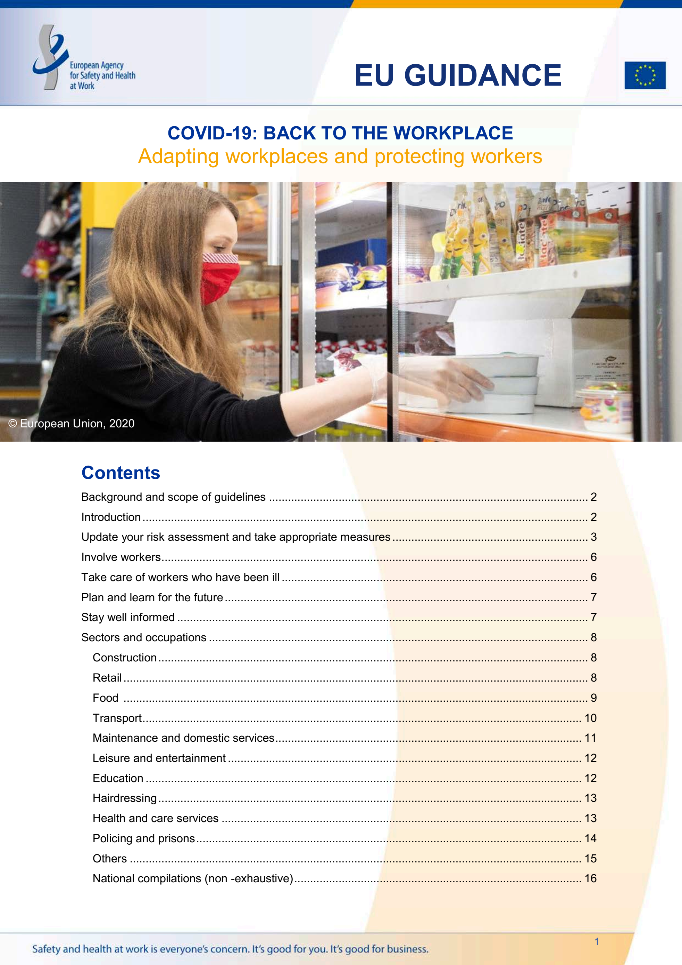

EU-OSHA COVID-19 Resources
Guidance for the workplace
Napo and COVID-19
Collection of national sectoral resources
Back to the workplace
OiRA COVID-19
https://osha.europa.eu/en/themes/covid-19-resources-workplace#pk_campaign=ban_homecw
Napo: https://youtu.be/TB_d6kfkWgM
Notes:
Here you can include more on the OSH wiki sectoral Resources? Show the educational Resources there?

Slide 25
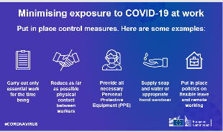
Covid-19 – Back to the workplace
Applicable legislation: Biological Agents Directive
Update of risk assessment and taking appropriate measures!
Hierarchy of control measures
  1. Technical measures
    Reorganising work processes
    Reducing physical contact between workers
    Barriers between workers
  2. Organisational measures
  3. Hygiene measures
  4. Personal protective measures
Information and consultation of workers
Other topics covered
  Mental health
  Vulnerable workers to work from home
  Teleworking
  Managing workers who work remotely
  Plan and learn for the future
Making use of occupational health service and health and safety advisor

Slide 26

OiRA COVID-19
National versions
ES (CAT & ES)
FR
PT
BG
CY
LT
LV
CZ
EL
BE (NL & FR)
HR
SL
Covers:
General measures
Workplace management
Ecouraging and enabling hygienic behaviour
Commuting to work/travel
Teleworking (optional)
Externals on site (optional)
Reopening premises after business closure (optional)
Meetings or events with externals (optional)
Business trips (optional)
Deliveries (optional)
Working on a clients premises (optional)
Added risks (by user)
https://oiraproject.eu/en/oira-tools?text=COVID&op=Search&sort=date
EU-OSHA tool updated beginning of June
Notes:
The tool has been published June 2020 and now updated. Update included better coordination between general RA and COVID measures, working at external premises & deliveries.
By now more tan 17000RA have been conducted with COVID tools - most of them in France, where there are subsidies for doing the RA, getting erimbursed 50% of costs for masks and hygienic gel.

Slide 27
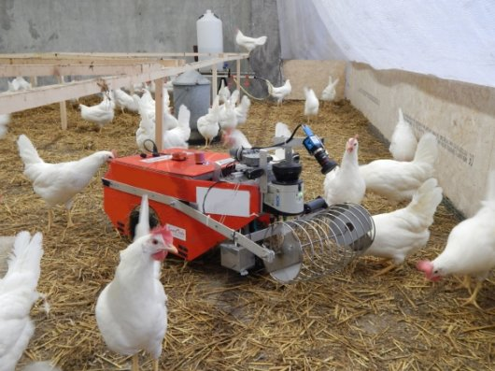
Thank you for your attention!
https://osha.europa.eu/
Email: starren@osha.europa.eu

